Slide 1
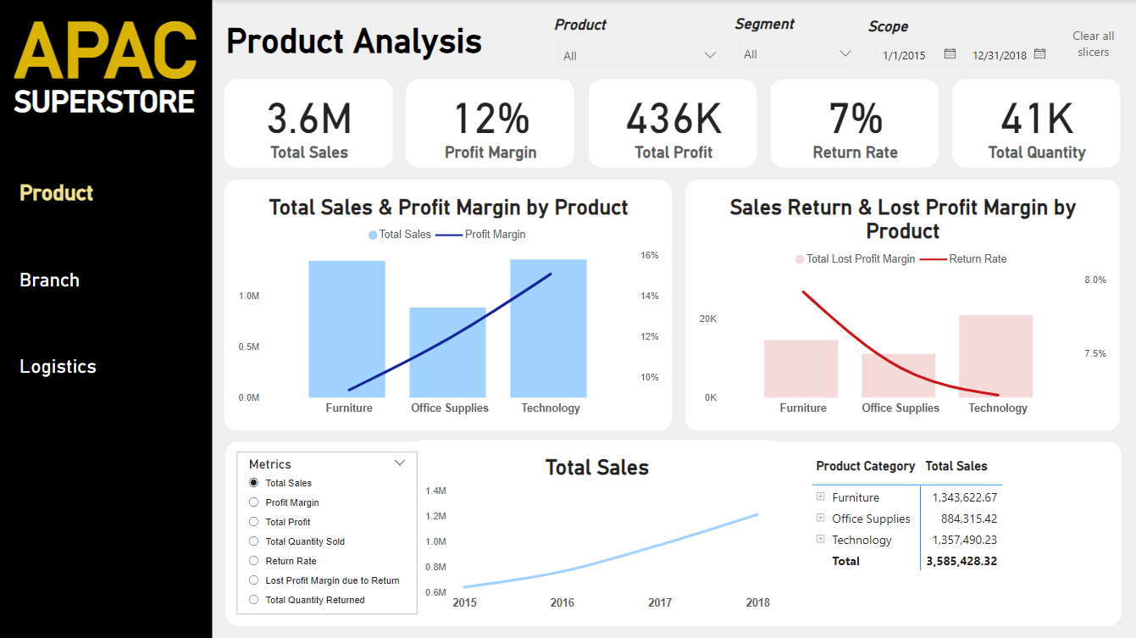

Slide 2
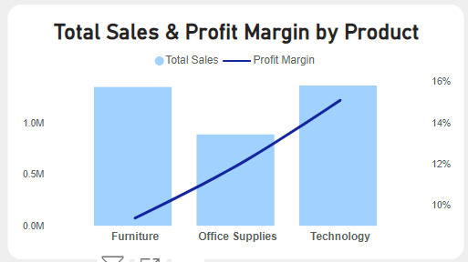
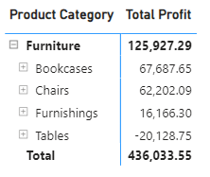
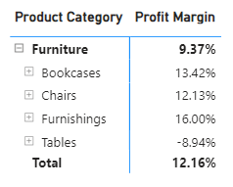
Product Analysis
APAC Superstore has a Total Sales of 3.6M, Total Quantity of Product sold of 41K, Return Rate of 7%,Total Profit of 436K and with a Profit Margin of 12% for the year 2015-2018.
The products of APAC Superstore are divided in 3 main categories; Technology, Furniture and Office Supplies.
Categories Technology and Furniture has almost equal of sales while the Office Supplies has the least sales.
Interestingly, Furniture is below the profit margin of 12% and has the lowest profit margin based on the fig 1 even though the sales is high.
Fig. 1
The sub-category of Furniture that contributes to its lower profit is Table. Based on the figs. 2&3, the profit from Tables yields negative profit and profit margin. The sub-category Table of Furniture is making a loss. Having a -8.94% profit margin, the supermarket is losing money in this product.
Fig. 2 & 3

Slide 3
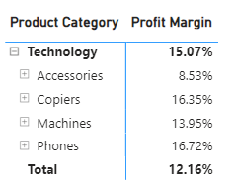
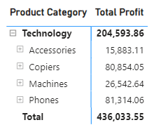
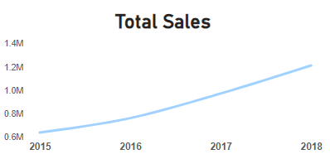
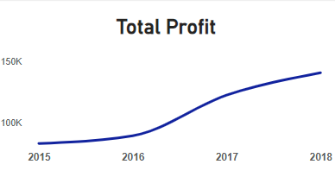
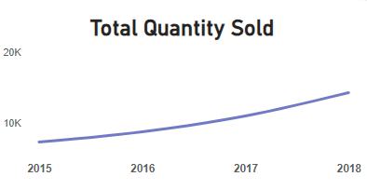
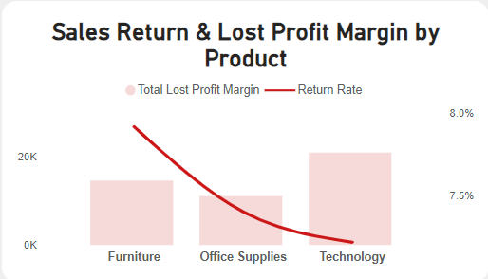
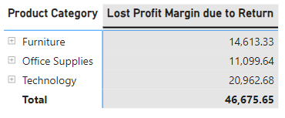
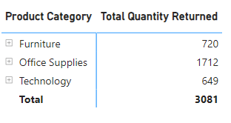
Product Analysis
The sub-category of Technology that contributes to its higher profit are Copiers and Phones. Based on the figs. 4&5, the profit from Copiers and Phones yields high profit and profit margin.
Fig. 4 & 5
Based on the Figs. 6, 7 & 8, the Total Sales, Total Profit and Total Quantity Sold from year 2015- 2018 has an Upward Trend.
Fig. 6,7&8
Figs. 9, 10 & 12 shows that Technology has the highest lost profit even though it has the lowest return rate while Furniture has the highest return rate.
Fig. 9
Fig. 10
Fig. 12

Slide 4
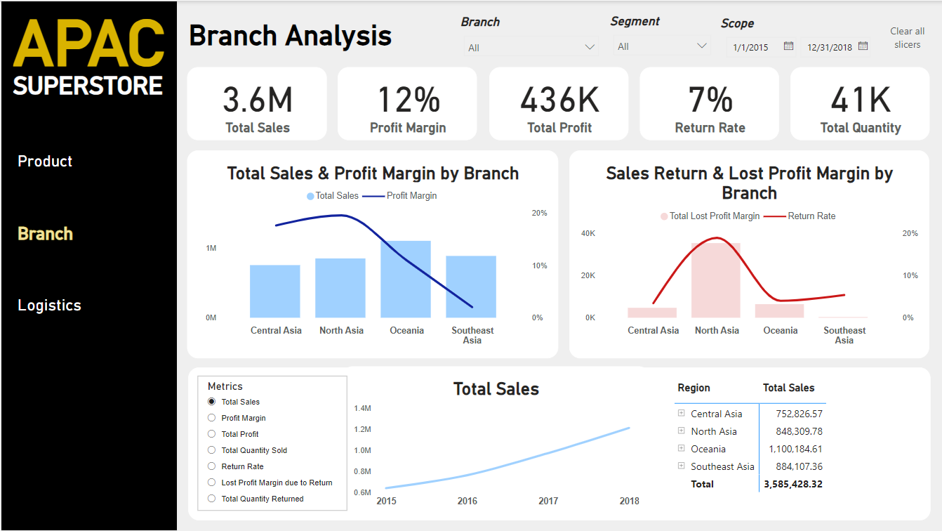

Slide 5
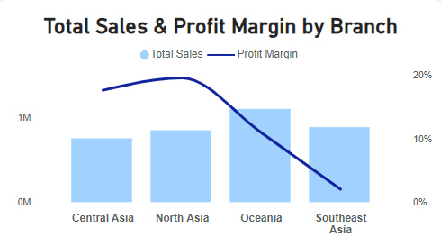
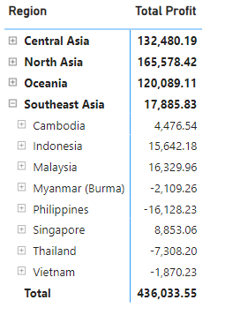
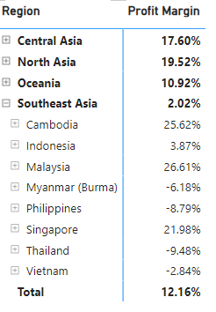
Branch Analysis
APAC Superstore has 4 main categories; Central Asia, North Asia, Oceania, Southeast Asia.
Fig.13 shows that the region of Oceania has the highest sale and others have almost the same sales.
Categories Technology and Furniture has almost equal of sales while the Office Supplies has the least sales.
Captivating, Southeast Asia is second on the highest sale however the profit margin is the lowest.
Fig. 13
The countries of Southeast Asia that contributes to its lower profit are Myanmar, Philippines, Thailand and Vietnam. Based on the figs. 14&15, the profit from these countries yields negative profit and profit margin. Having a negative profit margin, the supermarket is losing money in these countries.
Fig. 14 & 15

Slide 6
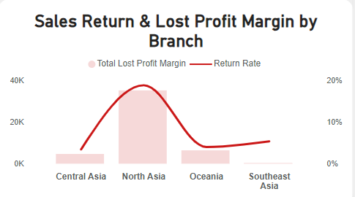
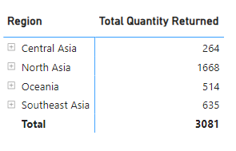
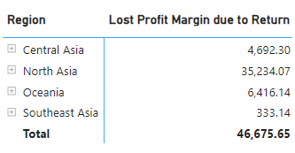
Branch Analysis
Fig. 16
Fig. 17
Fig. 18
Figs. 16, 17 & 18 shows that Southeast Asia has the lowest lost Profit however it has higher return rate than Central Asia and Oceania.

Slide 7
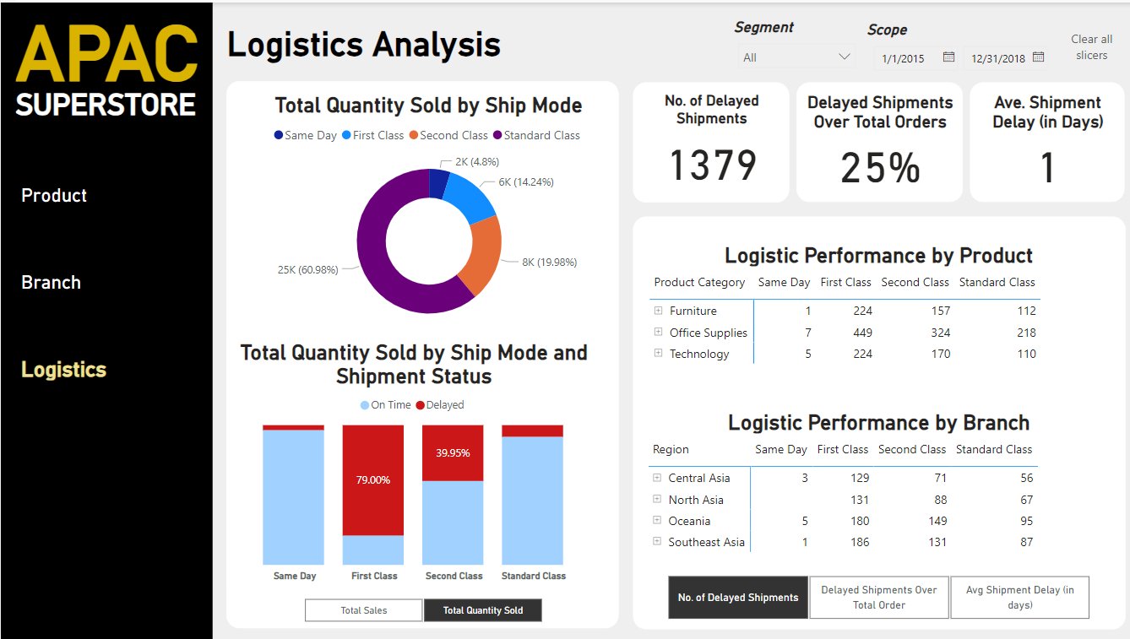

Slide 8
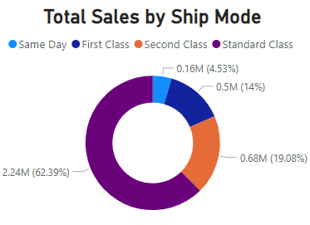
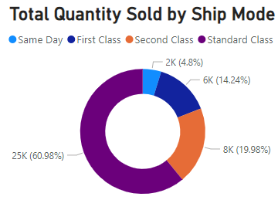
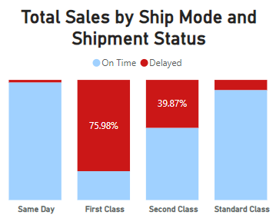
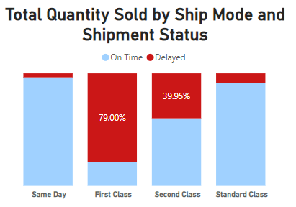
Logistic Analysis
APAC Superstore has 4 shipping mode; Same Day, First Class, Second Class and Standard Class.
Based on the number of distinct order made, there is a 1379 delayed shipment across all shipping mode. A 25% of the total orders are delayed. And there is an average shipment delay of one day.
Fig. 19 & 20 shows that the percentage of each shipping mode on total sales and total quantity sold are almost the same. It also shows that Standard Class is most sought shipping mode and Same Day is the least.
Fig. 19 & 20
Based on Fig. 21 & 22, First Class has the most percentage of delayed shipment followed by Second Class while Same Day has the least.
Fig. 21 & 22

Slide 9
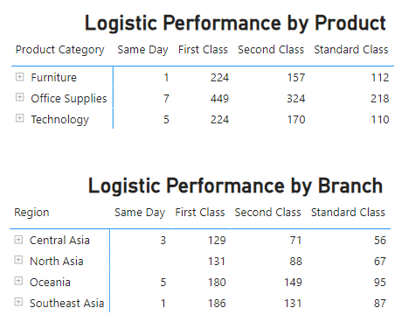
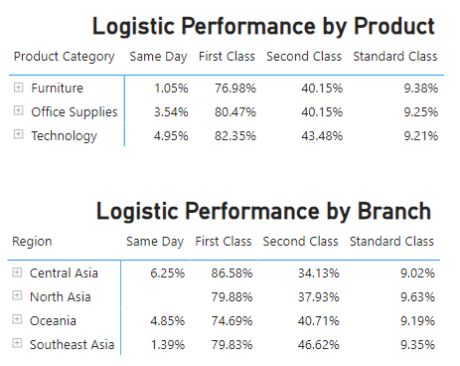
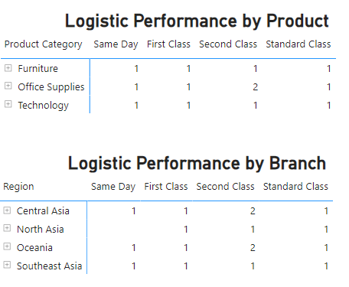
Logistic Analysis
Fig. 23
Fig. 24
Fig. 5
Fig. 23 show that the highest number of delayed shipment is Office Supplies in Products while in the branches, Oceania is the highest
Fig. 24 show that the percentage of delayed shipments over total orders are almost same through product and branches.
Across all shipment mode, the product and branches average delayed number of days of shipment is one day.

